Slide 1
Attention mechanism
Alberto TONDA, Ph.D. (Senior permanent researcher, DR)
UMR 518 MIA-PS, INRAE, AgroParisTech, Université Paris-Saclay UAR 3611, Institut des Systèmes Complexes de Paris Île-de-France

Slide 2
This is a new thing
Ciao
Ciaooooooooooooooo

Slide 3
What is Attention?
When dealing with sequences
Elements away from current position might have strong impact!
E.g. “Don’t go insane, find the real identity of, and kill one by one all the reviewers that have just rejected your awesome paper.”
“Don’t” here is extremely important for meaning of sentence
Seq2seq architectures (even LSTMs) tend to lose memory
Start of sequence has low impact on long sequences

Slide 4
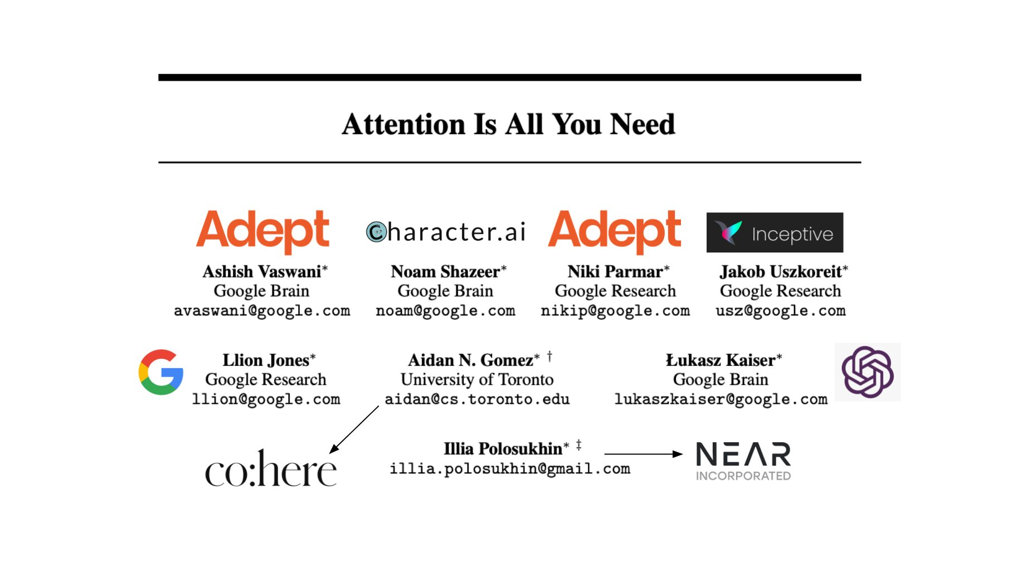
What is Attention?

Slide 5
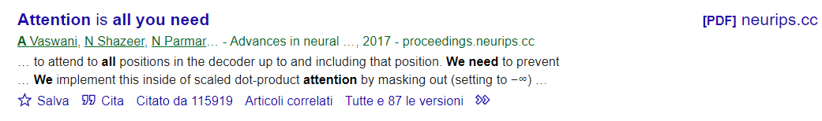
What is Attention?

Slide 6
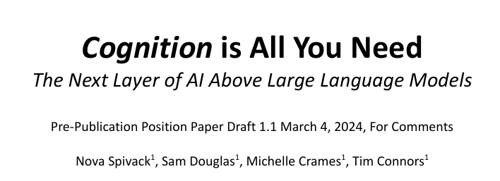
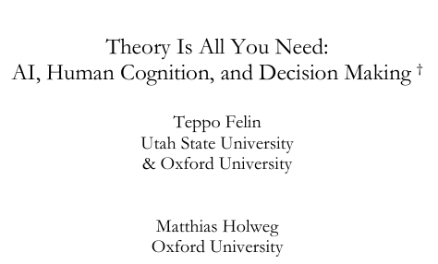
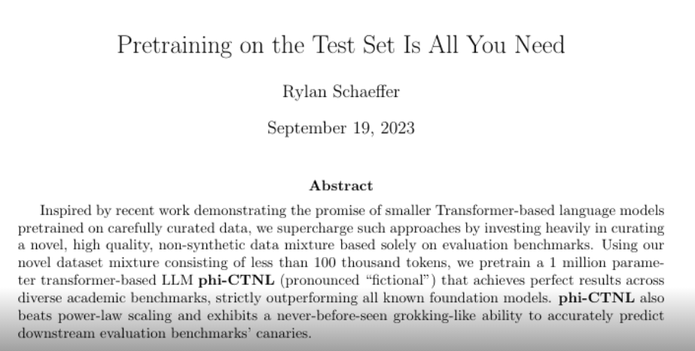
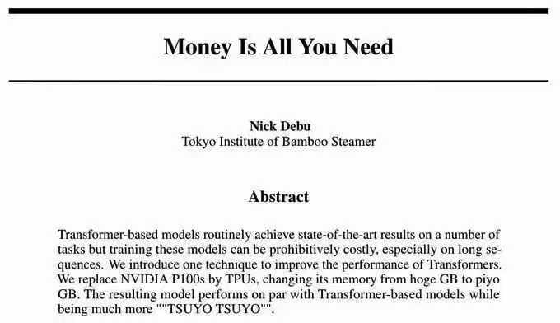
Emulation is the sincerest form of flattery

Slide 7
Obstacles in explaining Attention
Architecture of an Attention module has two aims
Follow a certain idea of what it should do (“what”)
Maximize computational speed (“how”)
The practical implementation can be hard to follow
Computations of Attention can be massively parallelized
“When it does not make sense, it makes speed”

Slide 8
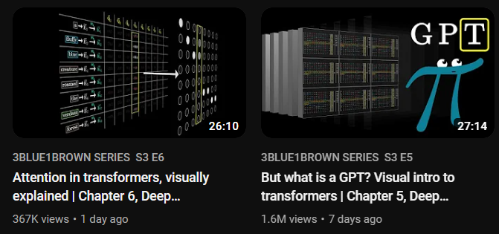
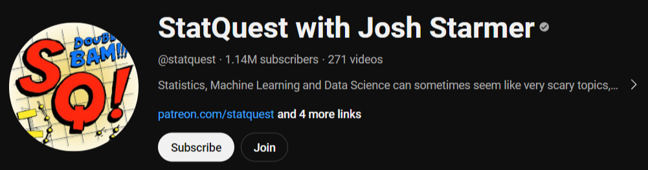
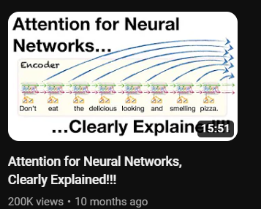
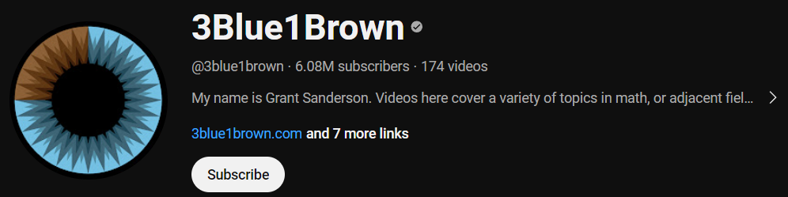
Attention, explained better than here

Slide 9

Attention, explained better than here

Slide 10
Attention
Attention is specifically designed to work on vocabularies
More specifically, embeddings of vocabularies
It can only work between two finite sets of discrete elements
Very often, the two sets are the same (self-attention)
But sometimes, different sets (cross-attention)
Encoding the way in which the presence of nearby tokens modifies the meaning (embedding) of a target token, for all tokens in the context window

Slide 11
Attention
Attention is specifically designed to work on vocabularies
More specifically, embeddings of vocabularies
It can only work between two finite sets of discrete elements
Very often, the two sets are the same (self-attention)
But sometimes, different sets (cross-attention)
Encoding the way in which the presence of nearby tokens modifies the meaning (embedding) of a target token, for all tokens in the context window
Meaning is encoded as a position in the embedding vector space; so, in practice, Attention computes a displacement in the embedding vector space that reflects the shift in meaning of the token, given the context.

Slide 12
Attention
“Don’t go insane, find the real identity of, and kill one by one all the reviewers that have just rejected your awesome paper.”
kill

Slide 13
Attention
“Don’t go insane, find the real identity of, and kill one by one all the reviewers that have just rejected your awesome paper.”
kill

Slide 14
Attention
“Don’t go insane, find the real identity of, and kill one by one all the reviewers that have just rejected your awesome paper.”
kill
kill
one

Slide 15
Attention
“Don’t go insane, find the real identity of, and kill one by one all the reviewers that have just rejected your awesome paper.”
kill
assassinate
kill
one
kill
everybody
massacre

Slide 16
Attention
“Don’t go insane, find the real identity of, and kill one by one all the reviewers that have just rejected your awesome paper.”
paper
kill
kill
kill
one

Slide 17
Attention
“Don’t go insane, find the real identity of, and kill one by one all the reviewers that have just rejected your awesome paper.”
paper
kill
kill
kill
one
don’t
kill
spare

Slide 18
Attention
“Don’t go insane, find the real identity of, and kill one by one all the reviewers that have just rejected your awesome paper.”
paper
kill
kill
kill
one
Attention module answers questions:
Which other tokens should modify target token?
In which direction?
By how much?
don’t
kill

Slide 19
Attention
Attention module
SOS
T₁
T₂
…
T_{N}
EOS
NA
…
NA
Size of the vocabulary
(one-hot encoding)
Size of the context window

Slide 20
Attention
Attention module
1
0
0
0
0
0
…
…
…
Size of the vocabulary
0
1
…
…
…
1
0
0
0
…
T_{N}
EOS
NA
…
NA
Size of the vocabulary
(one-hot encoding)
Size of the context window

Slide 21
Attention to positions…?
How does Attention take into account relative position of tokens in the sequence?

Slide 22
Attention to positions…?
Surprisingly, it doesn’t!
Displacements for all tokens are computed in parallel
The result is a sum of displacements, input order does not matter
The result of Attention is permutation-invariant wrt input (!!!)
Same displacements computed
“Don’t go insane, find the real identity of, and kill one by one all the reviewers that have just rejected your awesome paper.”
“Reviewers go insane. Don’t find the identity of one, kill all that have just rejected your one awesome paper, by”
How can we take into account the relative position?

Slide 23
Masking
Force a part of the matrix to zero
Prevent “future” tokens in sequence from influencing previous
Takes into account what comes before/after, coarse
Used in next-token prediction

Slide 24
Positional encoding
Encode the relative position of the token in its embedding
Small displacement added to the embedding of each token
Displacement is the same per same relative position in window

